Slide 1
E-commerce Platform for farmers
2021-135

Slide 2
Overall Project Description
Farmers face a problems when selling their products whether its vegetable or their old tools they have used.
Our objective is to provide solution through online platform .

Slide 3
Introduction to the overall project
Farmers face a lot of trouble when selling their products. Whether to sell their old tools or the vegetables they have grown.
Research Question
How can we help the farmers through online platform to sell their products

Slide 4
Objectives
Build a platform to help local farmers to perform online e-commerce transactions without any difficulties.
Sub Objective 1: Build an AI based voice recognition which identifies old tools and vegetables.
Sub Objective 2: Build an vegetable recommendation for cultivation
Sub Objective 3: Build a chat bot to assist the users who doesn’t know the names of the tools used in agriculture
Sub Objective 4: Dynamic prizing for vegetables.

Slide 5
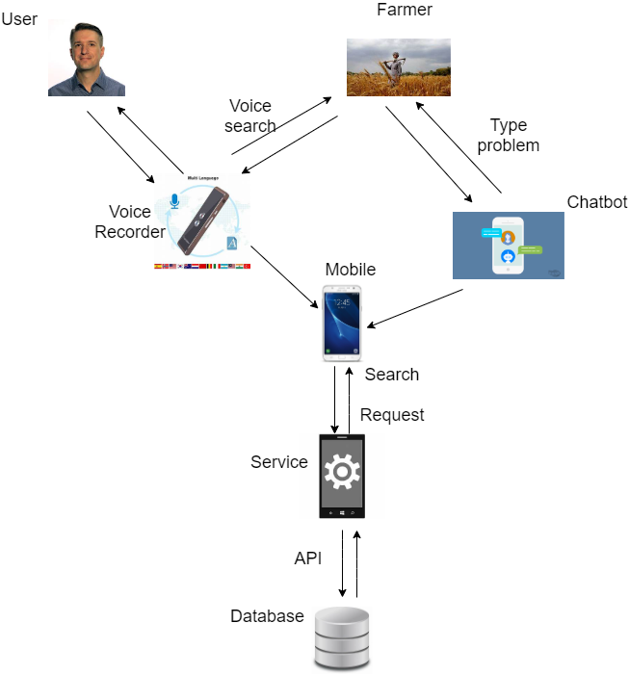
System overview

Slide 6
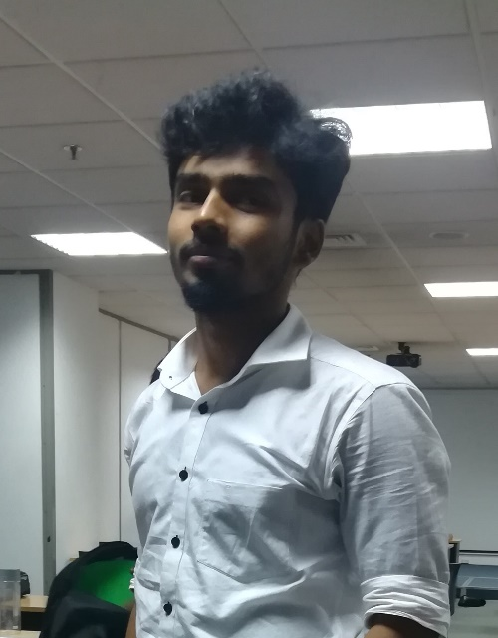
IT18186048-M.Anjanan
Bsc. Hons Information Technology specialization in Software Engineering

Slide 7
Introduction
Background/Research Gap – Farmers predicting a price for vegetable.
Research Question – How can farmers directly involve in predicting a price.
Specific and Sub Objectives – Creating a model to predict farmers price based on prediction.

Slide 8
Dynamic price prediction
Background
Fixing a price for vegetable independent of retailer’s market price in the aim of benefiting farmers as well as consumers.
Research Gap
Mostly price is predicted using historical market price. Farmers never participate in suggesting the price
Research Question
How can farmers fix a price on their own in an online platform?
Solution and objectives
Provide a price that is derived from farmers who suggest prices.
Getting suggestion from farmers for the vegetable price and analyze them through machine learning model and provide predicted price per day for vegetables

Slide 9
Research Methodology
System Diagram
Technologies, techniques, algorithms to be used
System, personal, and software specification Requirements
WBS

Slide 10
Algorithm and methods
Before implementing we need to implement a mobile application which takes the suggestion of prices of vegetables for their unit prices. These prices will be sorted by location provided by user.. Then we can feed the data into the model.
We have planned to use SVM model in order to classify. This will then classify the prices into clusters of farmers, such as low price farmer , genuine price farmer and high price farmer. From this we’ll take the average of the genuine price cluster and present it to the user.
Example; If a user input suggested price of carrot, tomatoe and brinjal , Based on his suggestion he will be categorized as low price farmer, or genuine price farmer or high price farmer. The price that will be finalized will be the average of genuine price farmer cluster.

Slide 11
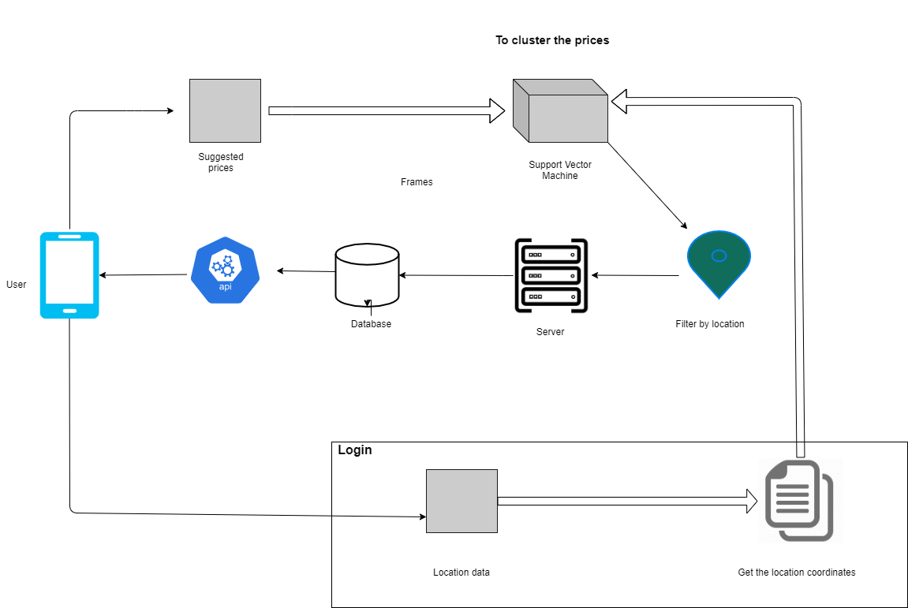
System Diagram

Slide 12
WBS
Build
Build an app for farmers​
Collect
Collect farmer’s suggested price from app​
Build
Build a model to cluster ​
Feed
Feed data to the model ​Testing

Slide 13
Technology
Flutter
Firebase
Machine Learninng
SVM

Slide 14
Supportive information
Commercialization
Budget

Slide 15
Commercialization
Mobile application which can predict daily price on farmers predictions and the farmers who predict closer to the predictions will be rated higher in the application.
Deploy app to the google play store

Slide 16
Budget
Cost | Price in Rs
To deploy to google app store | 4000.00

Slide 17
References
Are middlemen facilitators or barriers to improve smallholders' welfare in rural economies? Empirical evidence from Ethiopia- Gumataw. K. Abebe-2015
5 Tech Startups In India Working to Weed Out Middlemen From Agriculture Supply Chain - 26/09/2020 - https://analyticsindiamag.com/5-tech-startups-in-india-working-to-weed-out-middlemen-from-agriculture-supply-chain
Changshou Luo and Qingfeng Wei1, Prediction of Vegetable Price Based on Neural Network and Genetic Algorithm- Institute of Information on Science and Technology of Agriculture, Beijing Academy of Agriculture and Forestry Sciences, Beijing
Yung-Hsing Peng, Chin-Shun Hsu, and Po-Chuang Huang, "Developing Crop Price Forecasting Service Using Open Data from Taiwan Markets", 2015.
format

Slide 18
E-Commerce Platform For Farmers
2021-23

Slide 19
IT Number | Name
IT18181784 | Lathusha Sritharan
Supervisor Ms.Anjali Gamage

Slide 20
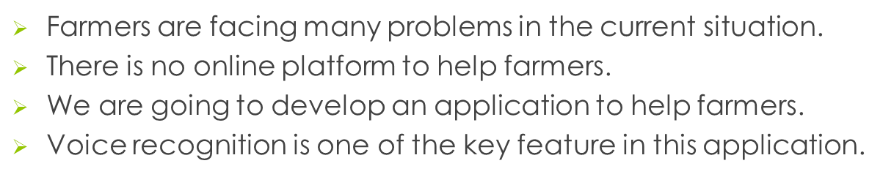
Introduction

Slide 21
Research Problem
In the current situation, Time is very important to everyone. Also farmers face many difficulties while using online applications. Typing is one of the big problem to farmers while using online app.
Delay in typing some tools or vegetables.
Some farmers know the words. But, don’t know how to type.
Many old farmers face problems in typing.
Most of farmers uneducated. So they can’t type word in other language.

Slide 22
Research Objective
Build an AI based speech recognition software to help farmers to identify old tools and vegetables by their speech.
When farmers tell the word in the software, it will find the actual text of the word using algorithms and give them suggestion to related things.

Slide 23
Introduction
Background study
In Jaffna, Most of farmers are uneducated and old. They don’t have a system to communicate other farmers. and They want to connect with other farmers.
They use mobile phones. But they are facing problem while typing. So that This speech recognition software will help them to solve this problem while using our E-Commerce Platform.

Slide 24
Research Gap
There are some applications use speech recognition software.
More people are using assistants like Google Home, Siri, and Amazon Alexa.
But there is no online voice recognition platform for farmers.
speech recognition much required implementation in this application since no research has been done focusing on that.

Slide 25
Objectives
Main Objective
Build a AI based Speech recognition which identifies old tools and vegetables. It works by breaking down the audio of a speech recording into individual sounds, analyzing each sound, using algorithms to find the most probable word fit in that language, and transcribing those sounds into text.

Slide 26
Specific Objectives
Understand human language and Analyzing each sounds
Using algorithms to find the most probable word fit in that language
Transcribing those sounds into text.
Suggest the product

Slide 27
Research Methodology
Speech recognition is the process that that trained to take input of human speech, interpret it and transcribe it into text. Speech recognition software works by breaking down the audio of a speech recording into individual sounds, analyzing each sound, using algorithms to find the most probable word fit in that language, and transcribing those sounds into text.

Slide 28
System Overview Diagram
user
Breaking down the sounds
Analyzing each sound
Speech recognition
Open the application
Human speech
Using algorithms
Convert into text
Find the word

Slide 29
Research Gap
Research Questions
Are farmers using any online platform to communicate

Slide 30
Technologies
Flutter
Firebase
Machine Learning
natural language processing
deep learning neural networks

Slide 31
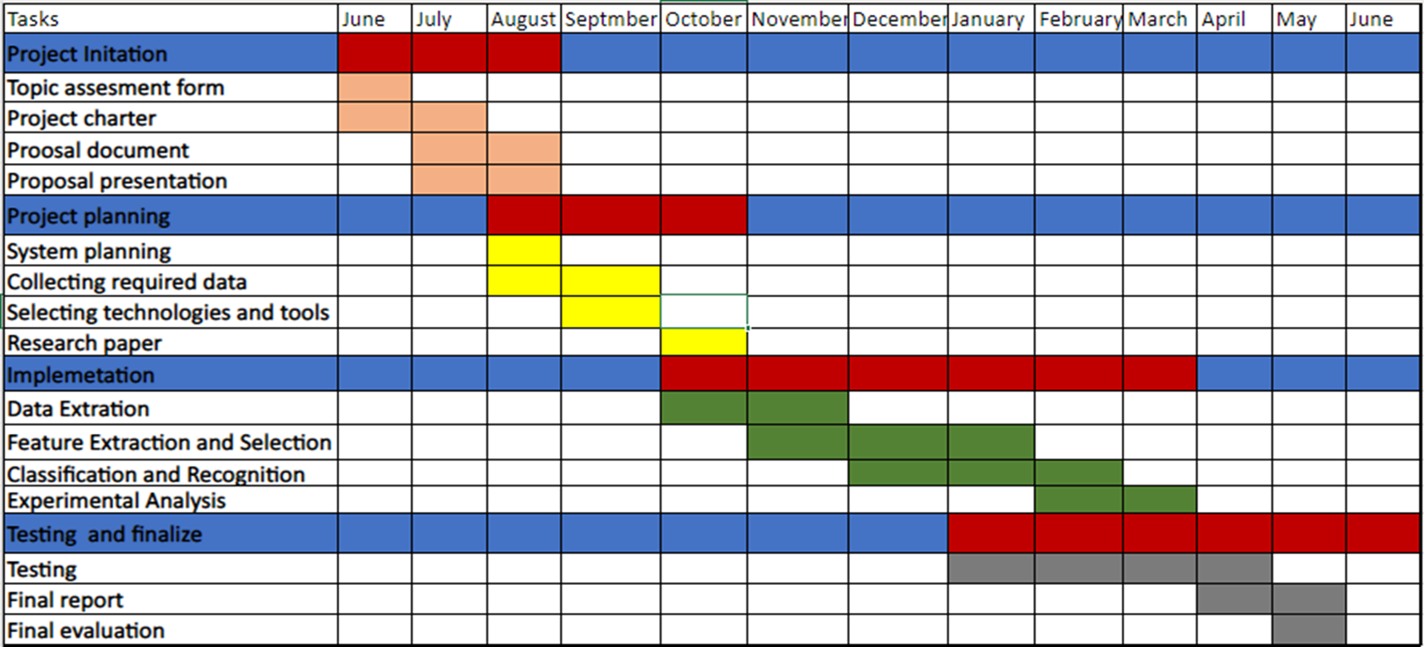
Gantt Chat

Slide 32
Budget
Description | Amount(LKR)
Internet Charges | 10,000.00
Transport Charges | 5,000.00
Other | 5,000.00
Total | 20,000.00

Slide 33
References
F. K. K. T. G. A. S. Burhanuddin Lakdawala, "Voice to Text transcription using CMU Sphinx A mobile application for healthcare organization," International Conference on Inventive Communication and Computational Technologies, p. 5, 2018.
S. J. Tripti Dodiya, "Speech Recognition System for Medical Domain," International Journal of Computer Science and Information Technologies, vol. 7, no. 1, p. 5, 2016.
N. M. Vishal Bhargava, "An Intelligent Speech Recognition System for Education System".
D. J. Picone, FUNDAMETALS OF SPEECH RECOGNITION: A SHORT COURSE, Mississippi , 1996.
T. B. N. P. P. L. N. Quang Minh Nguyen, "VAIS ASR: Building a conversational speech recognition system using language model combination," p. 3, 2019.
N. A. V. Samir Rustamov, "Automatic Speech Recognition in Taxi Call Service Systems," p. 11, 2019.
A. G. B. ́. B. G. G. H. M. ́. Q. S. S. ́. S. V. ́. Daniel Povey, "The Kaldi Speech Recognition Toolkit," p. 4, 2009.
P. K. B. G. R. S. W. W. Paul Lamere, "The CMU Sphinx-4 Speech Recognition System," p. 4, 2015.
A. S.-R. T.-B. Ș. D. Paula-Georgiana ZĂLHAN, "A Kaldi-based ASR Solution for the Romanian Judicial System," p. 8, 2016.
A. T. C. C. J. J. K. N. S. S. T. W. W. Z. Chung-Cheng Chiu, "Speech recognition for medical conversations," p. 5, 2018.

Slide 34
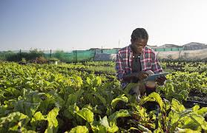
E-Commerce Platform for Farmers
Using Natural Language Processing chatbot

Slide 35

Introduction
There are many E-commerce platforms for farming activities. But which platforms are not fulfills all types of user requirements.
Chatbot is most important part for E-commerce farming activity.
Farmers spending too much of time to identify some new farming product names for buying and selling purpose.
Because of the climate changes various kind of diseases damaging farming activities. But farmers don’t know about their names and solutions.
Our AI technology chatbot providing solutions for farmers problems by using Natural Language Process.

Slide 36
Main Components
Perform a through research suggest the marketing availability which are needed for farmers.
Find out the correct name of the product from farmers’ simple description.
Analyze and suggest the solutions for some farming problems in understandable way.

Slide 37
Research Objectives
Develop a chatbot to discuss the issues related to farming and suggest the best solutions for their farming problems in Natural Language Processing.
Support farmers to make timely decision in farming.

Slide 38
Research Gap
Research Question
Farmers have simple description and don’t know the disease name and correct solutions
Farmers can’t understand the standard languages output from chatbot.
Farmers have an idea of a product but they don’t know the actual name.
Creative Solution
Using chatbot to typing their simple problem description.
Providing correct solutions in Natural Language Process.

Slide 39
Functional Requirement
Providing suggestions for farming problems in Natural Language Process.
Getting keywords from disease description providing diseases names and suggestions.

Slide 40

Non-Functional Requirement
Less manual work
Time Management – Take less time to getting products, diseases names and their description.
Decisions – Coming out to the correct solutions from different farming issues.

Slide 41


Technologies
Python
Firebase

Slide 42

Problem
Farmers confuse their plants affected by some new diseases.
Farmers don’t have any resources to get new product names in their familiar language.
Solution
Quickly providing correct suggestions.
Automatically suggesting new ideas related to the season and current location.

Slide 43


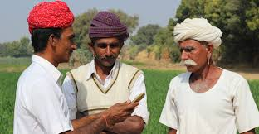
Methodology
Data Send to the firebase
Chatbot will provide suggestions.
Getting description from farmers
IT18260502 | K.MARUTHI

Slide 44
Data Preprocessing
Compute similar words
Create a group of related words
Feature for text classification
suggest similar words to the word being subjected to the prediction model.
Along with that it also suggests dissimilar words, as well as most common words.
Used for semantic grouping which will group things of similar characteristic together and dissimilar far away.
Text-based classifier models cannot be trained on the string, so this will convert the text into machine trainable form.
Further its features of building semantic help in text-based classification.

Slide 45
Work Breakdown Structure
Getting real problem of farmers and provide support by suggesting solutions
Project Imitation
Topic Selection
Requirements gatherings
Background study
Literature Survey
Technology survey
Documentation
Topic Registration form
Project Charter
Proposal Document
Progress Document
Final Document
Implementation
Prepare similarity finder .
implement classification algorithm
Testing
Unit Testing
Component Testing
System Testing
User Testing
Maintenance

Slide 46
References
Jia, J. (2003). The Study of the Application of a Keywords-based Chatbot System on the Teaching of Foreign Languages. ArXiv preprint cs/0310018.
Matney, L. (2016, August 03). Kik users have exchanged over 1.8 billion messages with the platform’s 20,000 chatbots.
Huang, J., Zhou, M., & Yang, D. (2007). Extracting Chatbot Knowledge from Online Discussion Forums. IJCAI'07 Proceedings of the 20th international joint conference on Artifical intelligence, 423–428.
[Joachims, 2002] T. Joachims. Optimizing Search Engines Using Clickthrough Data. In Proceedings of the ACM Conference on Knowledge Discovery and Data Mining (KDD), pp.133-142, 2002.
Abdul-Kader, S., & Woods, J. (2015). Survey on Chatbot Design Techniques in Speech Conversation Systems. International Journal of Advanced Computer Science and Applications, 6(7). M. J. Pereira, and L. Coheur, “Just. Chat-a platform for processing information to be used in chatbots,” 2013
D. Mladenić, and L. Bradeško, “A survey of chabot system through a Loebner prize competition,” 2012.
F. A. Mikic, J. C. Burguillo, M. Llamas, D. A. Rodríguez, and E. Rodríguez, "CHARLIE: An AIML-based Chatterbot which Works as an Interface among INES and Humans." pp. 1-6, 2009.

Slide 47
Thank you!!

Slide 48

R.Jayaraman - IT16037984
Specialization in Information Technology

Slide 49
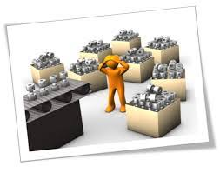
Vegetable recommendation
Sometimes seasonal vegetable also has a low price due to excessive production. We can give a solution by give a suggestion of which vegetables to cultivate.

Slide 50
Research gap
There is no solution telling to individual farmers exactly which product gives more profit.
Research problems
Farmers don't get enough profit.
Excessive production of crops.
Don't know profitable products.
Can't access data easily.
Introduction

Slide 51
Objective
List the top profitable vegetables individually.
Sub objective
Find the profitable vegetables from list of vegetables
Suggest profitable vegetables for farmers individually
List vegetable not to cultivate to stop overproduction

Slide 52
This section MUST include following sections
System Diagram
Technologies, techniques, algorithms to be used
System, personal, and software specification Requirements
WBS
Note: You should use “Individual Title and Content” Slide layout to add the details
Research Methodology

Slide 53
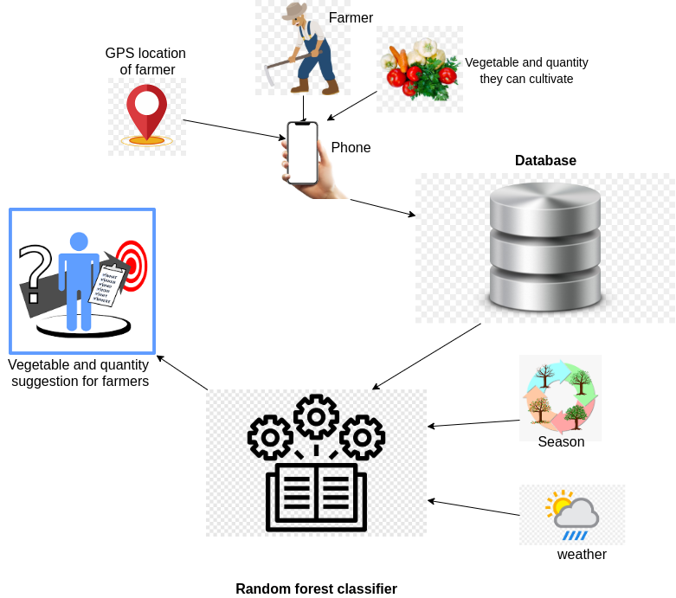
System Overview Diagram

Slide 54
Work breakdown structure
Build an app for farmers
Collect farmer details, supply details, price from app
Build a model to suggest vegetable for farmers
Feed data to the model
Testing

Slide 55
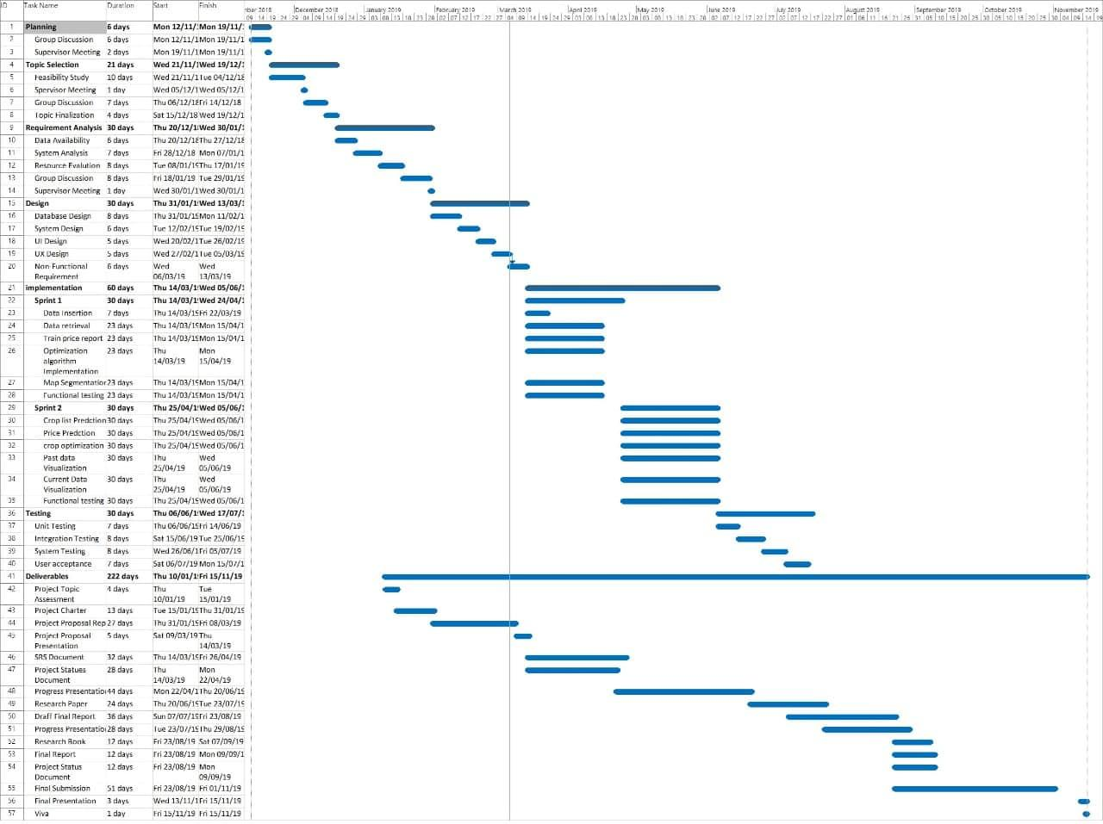
Gantt chart

Slide 56




Technologies

Slide 57
Supportive information
This section MUST include following sections
Commercialization
Budget (if any)
Note: You should use “Individual Title and Content” Slide layout to add the details

Slide 58



Commercialization

Slide 59
References
[1] T. van Klompenburg, A. Kassahun, and C. Catal, “Crop yield prediction using machine learning: A systematic literature review,” Comput. Electron. Agric., vol. 177, no. 105709, p. 105709, 2020.
[2] S. Khaki and L. Wang, “Crop yield prediction using deep neural networks,” Front. Plant Sci., vol. 10, p. 621, 2019.
[3] M. Kalimuthu, P. Vaishnavi, and M. Kishore, “Crop Prediction using Machine Learning,” in 2020 Third International Conference on Smart Systems and Inventive Technology (ICSSIT), 2020, pp. 926–932.
[4] M. Suganya, D. R, and R. R, “Crop yield prediction using supervised learning techniques,” 2020.
[5] D. Praveen et al., “Crop yield forecasting,” Academia.edu. [Online]. Available: https://www.academia.edu/Documents/in/Crop_yield_forecasting. [Accessed: 24-Feb-2021].
[6] Mahendra N and PES College of Engineering, “Crop Prediction using Machine Learning Approaches,” Int. J. Eng. Res. Technol. (Ahmedabad), vol. V9, no. 08, 2020.

